Slide 1
L02.03 Heap (II)
50.004 Introduction to Algorithm
Dr. Simon LUI
ISTD, SUTD

Slide 2
What is this lecture about
It is a simpler version of Heap I (L02.02)
With step by step examples

Slide 3
Build Max Heap

Slide 4
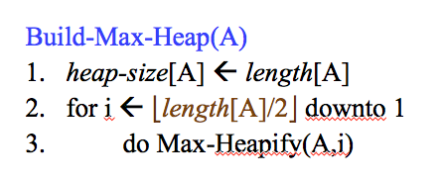
Build Max Heap

Slide 5
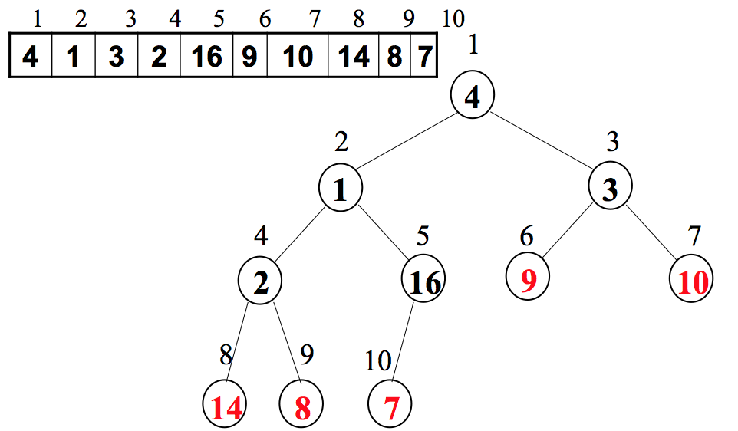
Example: Build_Max_Heap
Red: leaves
Black: non leaves
We only Heapify the black nodes

Slide 6
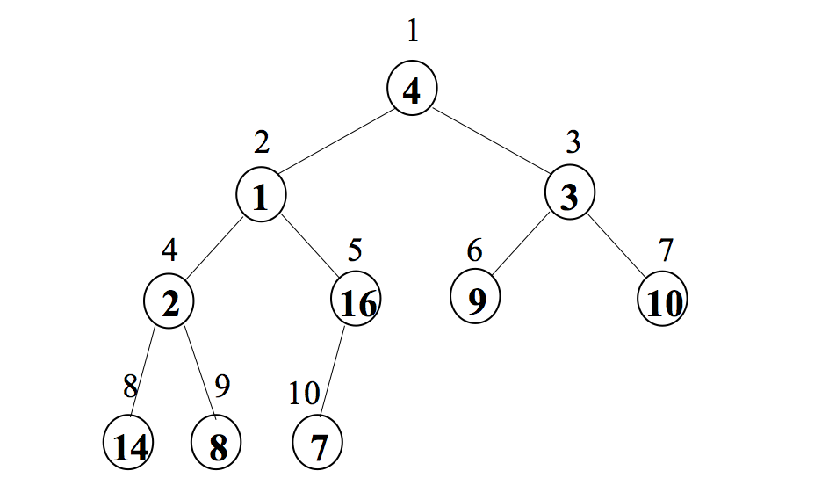
Example: Build_Max_Heap
Heapify(A,5)

Slide 7
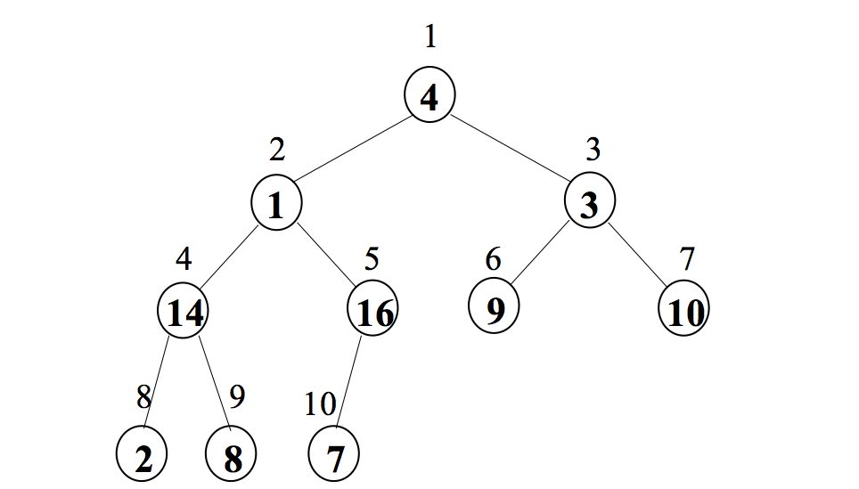
Example: Build_Max_Heap
Heapify(A,4)

Slide 8
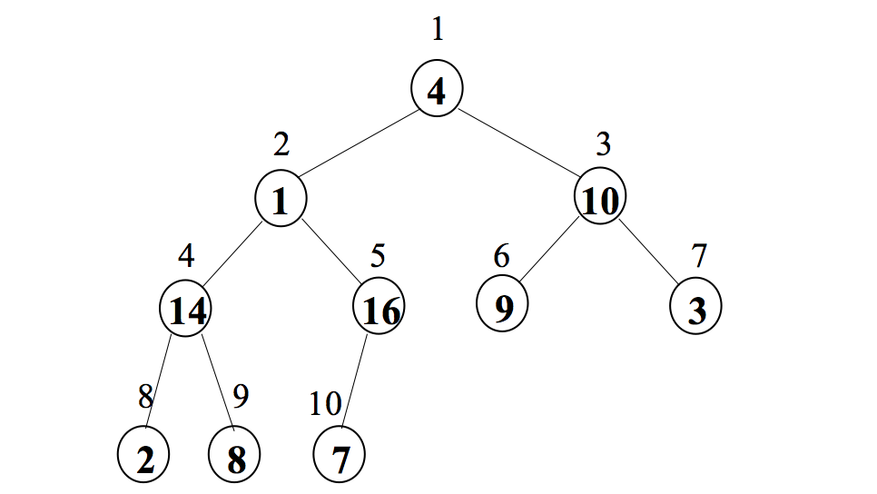
Example: Build_Max_Heap
Heapify(A,3)

Slide 9
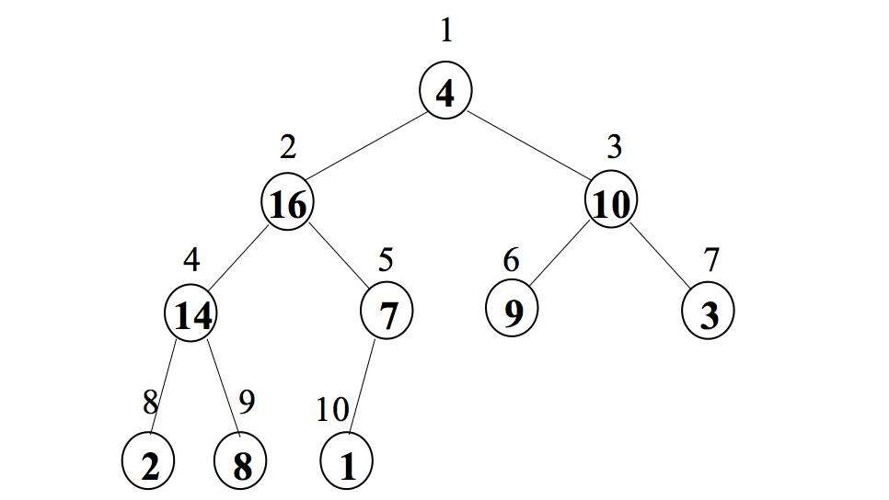
Example: Build_Max_Heap
Heapify(A,2)

Slide 10
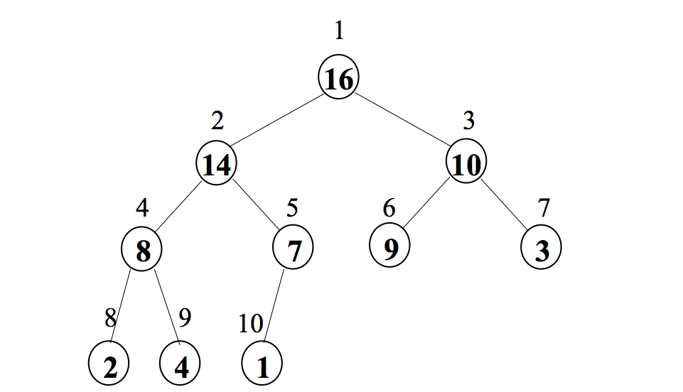
Example: Build_Max_Heap
Heapify(A,1)

Slide 11
Heapify

Slide 12
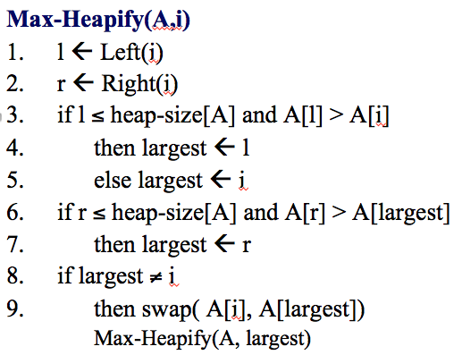
Heapify

Slide 13
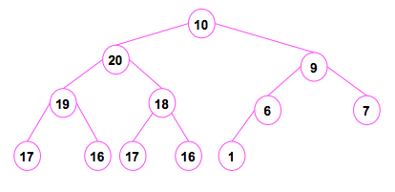
Example: Heapify
Node(1) violates the max heap rule

Slide 14
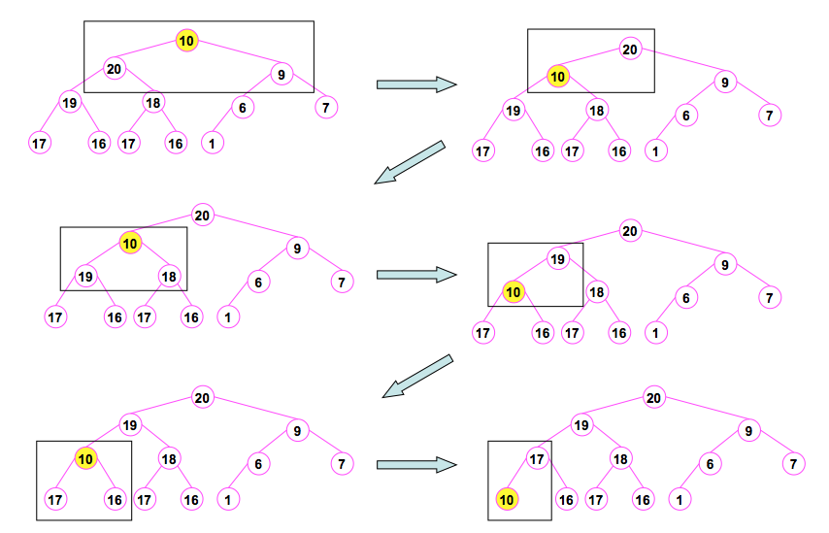
Example: Heapify

Slide 15
Priority Queue

Slide 16
Priority Queue
There are many kinds of priority Queue
Array Priority Queue
List Priority Queue
Heap Priority Queue
We will work on this today

Slide 17
Priority Queue operations
Insert(A,key): insert a key, then heapify and maintain the heap structure
Max(A): returns the largest key
Extract-Max(A): returns the largest key, remove it, then heapify and maintains the heap property
Increase-Key(A,i,key): Increase the key of index i

Slide 18
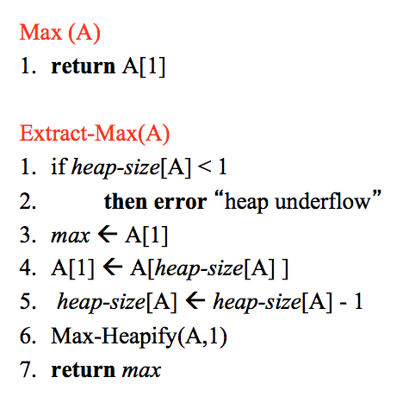
Priority Queue – the algorithm

Slide 19
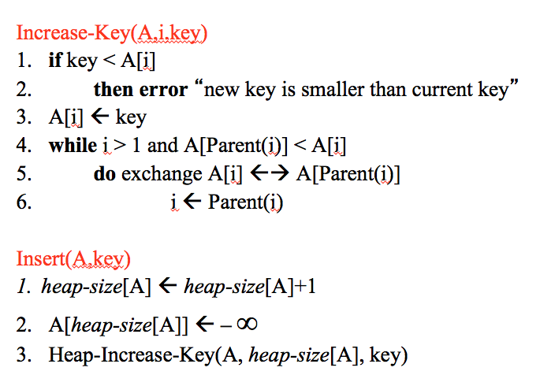
Priority Queue – the algorithm

Slide 20
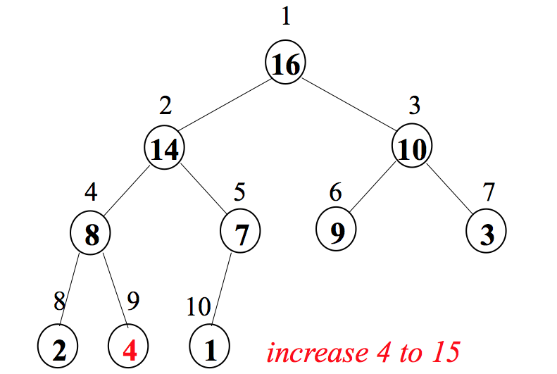
Example: increase key

Slide 21
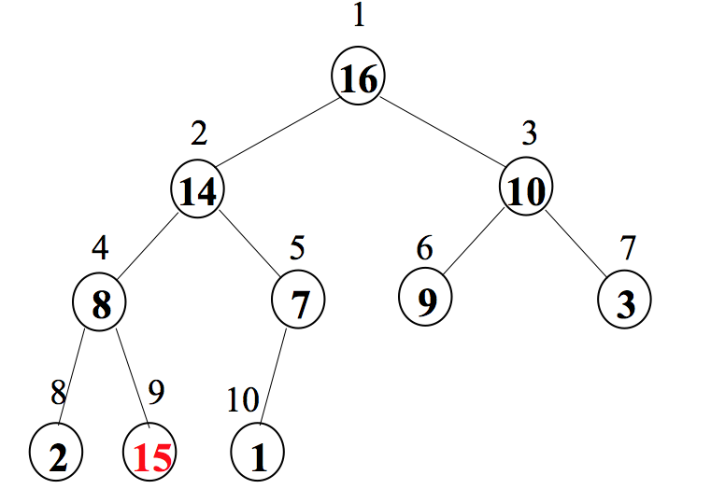
Example: increase key

Slide 22
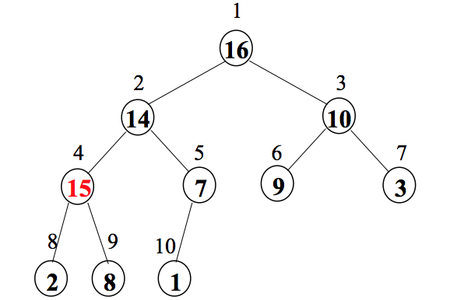
Example: increase key

Slide 23
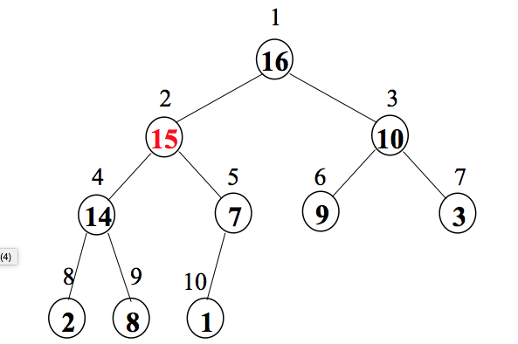
Example: increase key

Slide 24
Heap sort

Slide 25
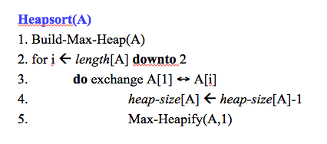
Heap sort

Slide 26
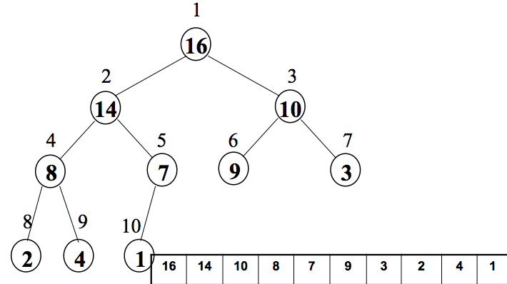
Example: Heap sort
Build a max Heap

Slide 27
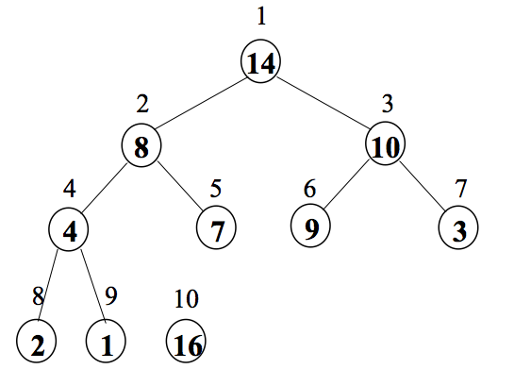
Example: Heap sort
Exchange A[1] and A[10]
Heapify(A,1)
Isolate (output) A[10]

Slide 28
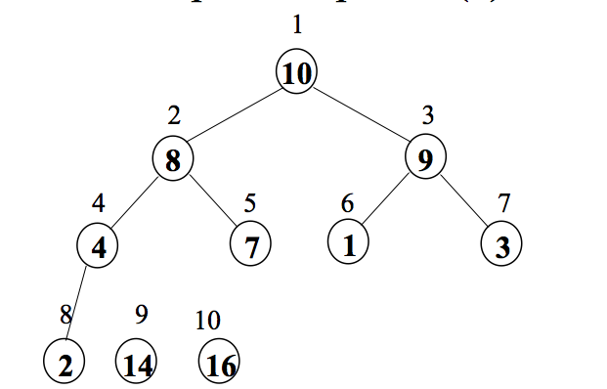
Example: Heap sort
Exchange A[1] and A[9]
Heapify(A,1)
Isolate (output) A[9]

Slide 29
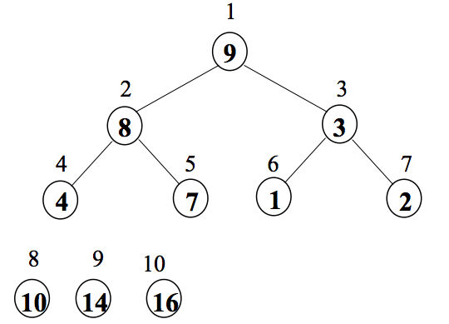
Example: Heap sort
Exchange A[1] and A[8]
Heapify(A,1)
Isolate (output) A[8]

Slide 30
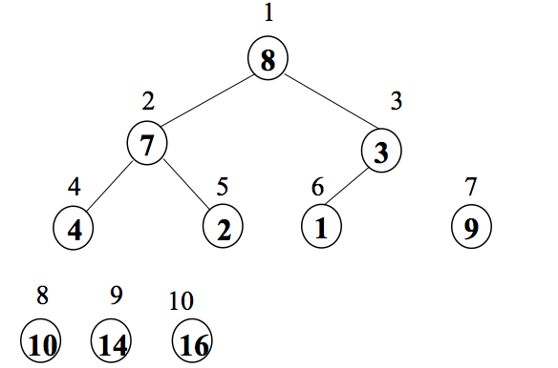
Example: Heap sort
Exchange A[1] and A[7]
Heapify(A,1)
Isolate (output) A[7]

Slide 31
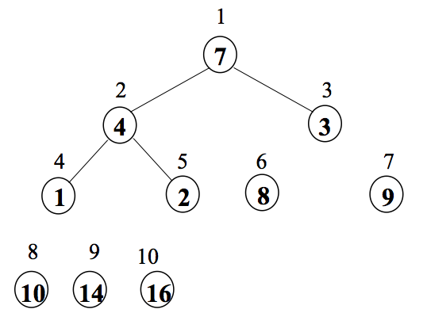
Example: Heap sort
Exchange A[1] and A[6]
Heapify(A,1)
Isolate (output) A[6]

Slide 32
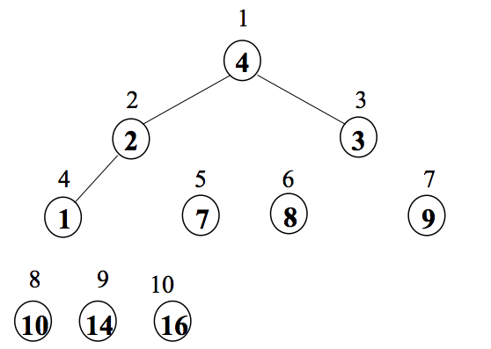
Example: Heap sort
Exchange A[1] and A[5]
Heapify(A,1)
Isolate (output) A[5]

Slide 33
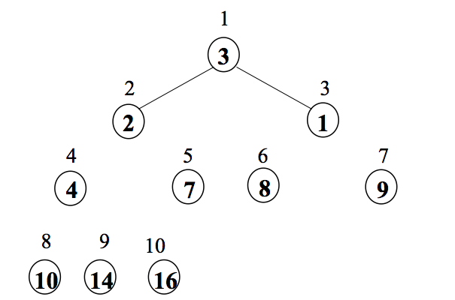
Example: Heap sort
Exchange A[1] and A[4]
Heapify(A,1)
Isolate (output) A[4]

Slide 34
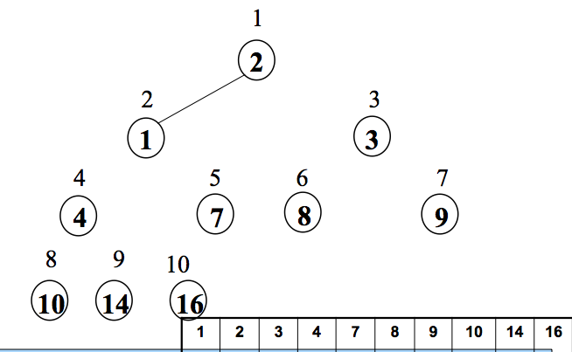
Example: Heap sort
Exchange A[1] and A[3]
Heapify(A,1)
Isolate (output) A[3]
End the program at i=2
The isolated keys form the solution!

Slide 35
Application

Slide 36
Application of Priority Queue
Used as stack
For Dijkstra’s algorithm (find the shortest path from 1 node to another) – week 9
For Prim’s algorithm (find the minimum spanning tree) – week 6

Slide 37
Application of Heap
To implement a priority Queue
To implement heapsort
Computer virtual memory

